Slide 1
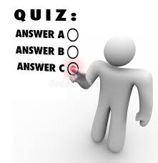
Online Quiz System
Using Maps and Lists to Manage Questions and Scores
The Online Quiz System is an innovative platform designed to facilitate seamless quiz creation, management, and evaluation for educators, learners, and administrators. Leveraging the power of Maps and Lists as data structures, this system ensures efficient handling of questions, answers, and scores while maintaining a user-friendly and organized experience.
Team members
2310030366 – V Nikhil Chandra
2310030291 – G Sai Krishna
2310030322 – N Charan Reddy
2310030353 – K Sai Dheeraj

Slide 2
Modules
User Management
Quiz Management
Question Bank
Scoring System
Result Analysis
Admin Panel

Slide 3
UML Diagrams Overview
Class Diagram
Use Case Diagram
Interaction Diagram
State Chart Diagram
Activity Diagram

Slide 4
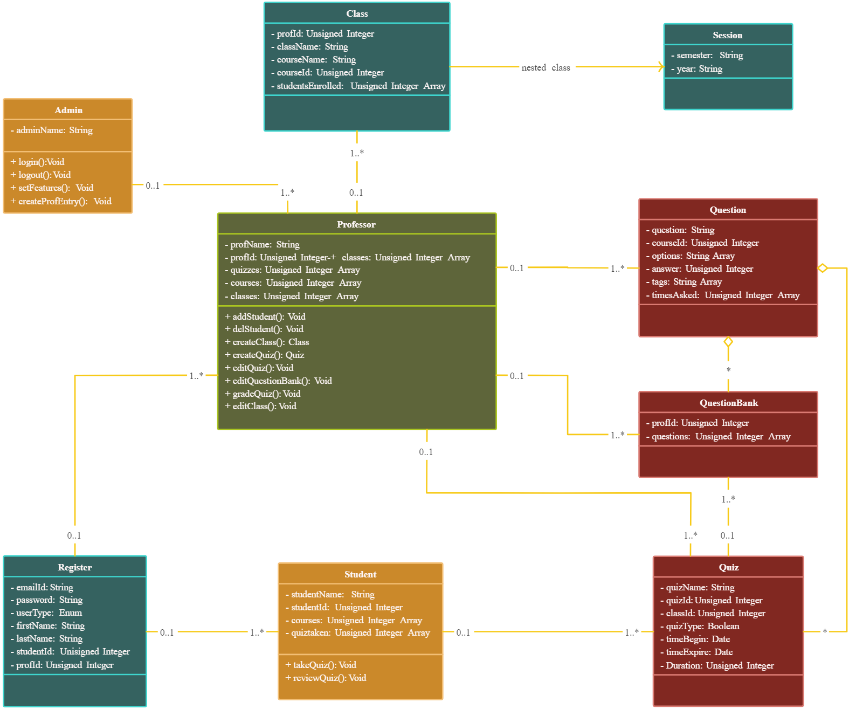
Class Diagram

Slide 5
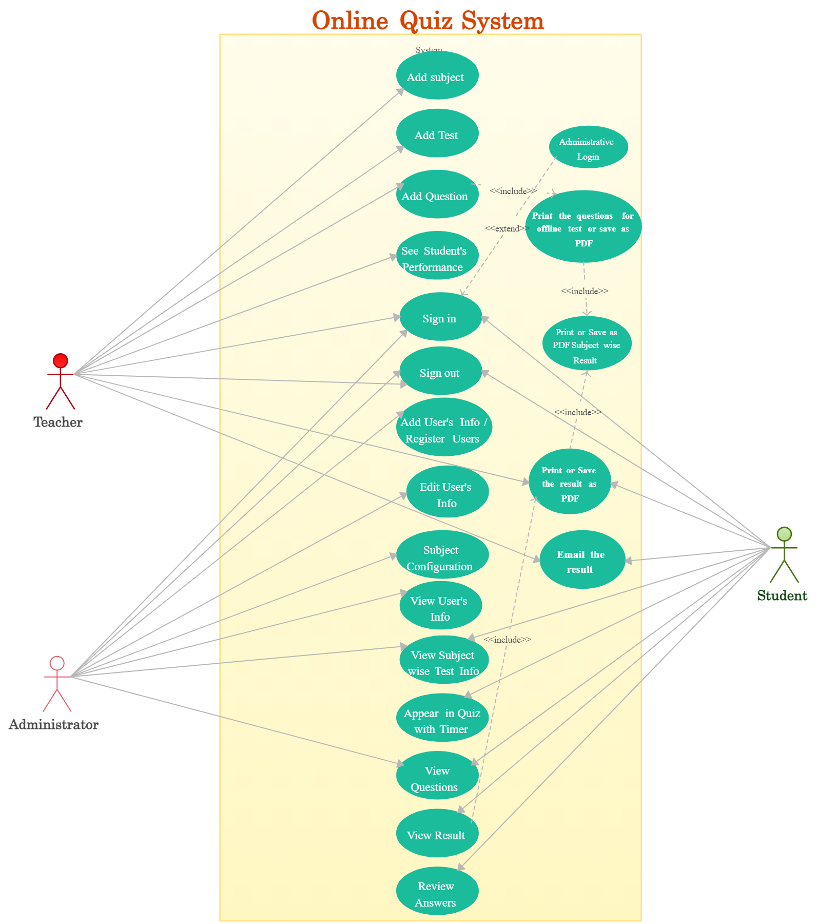
Use Case Diagram
The diagram illustrates an Online Quiz System with three
primary roles: Teacher, Administrator, and Student.
Teachers: Add subjects, create tests and questions, view
student performance, and manage user information.
They can also print or save results and questions as PDFs.
Administrators: Oversee subjects, users, and tests,
review questions and answers, and manage system
configurations.
Students: Participate in quizzes with a timer,
view questions, check results, review answers,
and save or email their results.

Slide 6
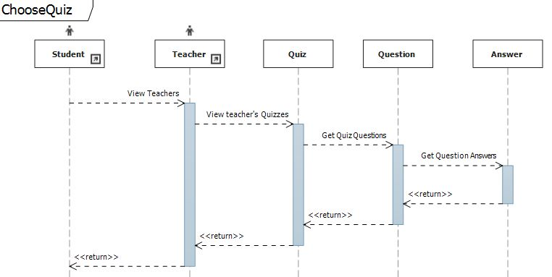
Interaction Diagram

Slide 7
State Chart Diagram
Quiz States
[Quiz created]
[Quiz created]
Not yet open
Open
Closed
Attempt states
[2minutes after submit all and finish]
[attempt started]
[Submit all and finish]
Attempt in Progress
Immediately after the attempt
Attempt finished

Slide 8
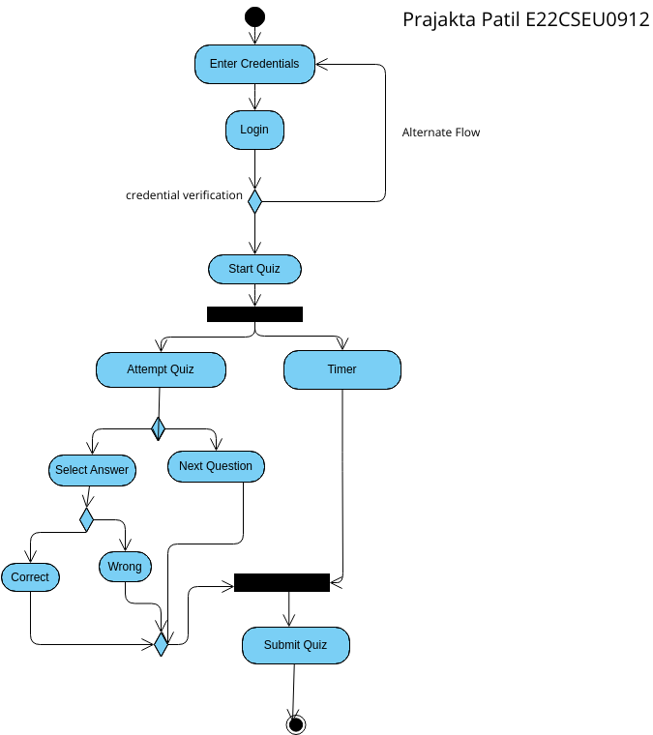
Activity Diagram

